Slide 1
Do context-specific housekeeping genes exist?
BBMS4001 Final Year Project Final oral presentation
Supervisor: Dr. David SHIH Jen Hao
3035603370 HAN Ye Ri
Notes:
Good morning. My name is Yeri Han and today I will be presenting about my final Year project named <do context-specific housekeeping genes exist?>.

Slide 2
Key words
Context-specific: (expression is) specific to the context and condition of the tissue
Housekeeping genes: the essential genes that are constitutively expressed in all types of the cell
Notes:
There are a few key words I would like you to pay attention to, they will be explained in more detail in the later part of the presentation. Context-specific means specific to the context and condition of the tissue. And housekeeping genes are the essential genes that are expressed or transcribed in an ongoing manner in all type of the cell.

Slide 3
Background
Housekeeping genes are a group of genes in living organisms that are ubiquitously expressed at a certain level regardless of any conditions
Perform basic and vital functions of the cell: cell structure integrity maintenance, movement, energy metabolism etc.
Expressed consistently at high level across diverse tissue
Used as reference genes in gene expression analysis using qPCR technique
However, many studies have pointed out that different conditions may affect this property = inconsistent expression across some types of tissue and settings
Notes:
First of all, let’s begin with some background of study.
All cells in our body have the same genetic content but we have all sorts of different cells. How is this possible? This is because we control the level of expression of different genes in the different tissue. But if one gene codes for a protein that is essential for the cell’s survival, we will be able to see this gene switched on in every type of the cell all the time. These genes are called, housekeeping genes. They are a group of genes in living organisms that are ubiquitously expressed at a certain level in any condition.
They usually code for proteins and RNAs that perform basic and vital functions of the cell. For instance, maintaining cell structure integrity, movement, metabolism etc. They are expressed consistently at high level across diverse tissue. Due to such properties, many housekeeping genes like GAPDH and ACTB are often used as reference genes in gene expression analysis experiments using qPCR technique.
However, increasing number of studies have been reporting that the expression of housekeeping genes can be highly variable in different tissues and settings.

Slide 4
Study Aim
To find new candidates of housekeeping genes that can be used across broad contexts and reveal the patterns of the differential expressions in them.
Context-specific housekeeping gene: housekeeping genes that are expressed at consistent levels in a particular cell type or stage of development; invariant across broad contexts of tissue types and disease status.
Notes:
In this computational biology study, I aimed to identify new candidates of housekeeping genes that can be used across broad contexts and reveal the patterns of the differential expressions in them.
Through this, I expected to find out the context-specific housekeeping genes, which are the genes that are expressed at consistent levels in particular cell types or stage of development of the cell and invariant across broad contexts.

Slide 5
Methods and materials
Gene expression dataset: Pan-Cancer Atlas (PanCan)
Profiles 33 different tumors types at different levels (DNA, RNA, etc..)
RNA-seq data of 10,982 samples and 20,386 genes
Program used: R
Notes:
Moving on, this is how the study was done.
The gene expression dataset used in the study was the Pan-Cancer Atlas (PanCan). PanCan profiles 33 different tumor types at DNA, RNA, protein, and epigenetic levels. The dataset used in the study contains RNA-seq data of 10,982 samples and 20,386 different genes. R was used for pre-processing of the data, statistical analysis, and construction of the plots.

Slide 6
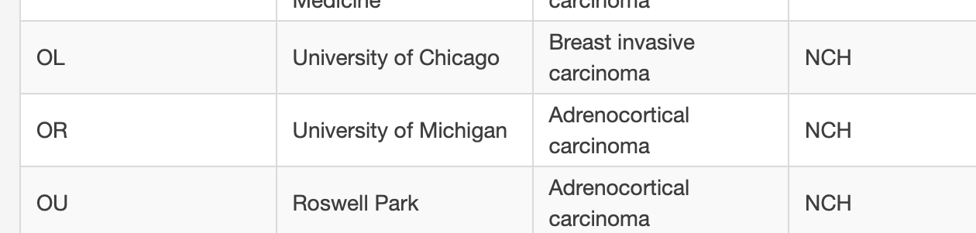
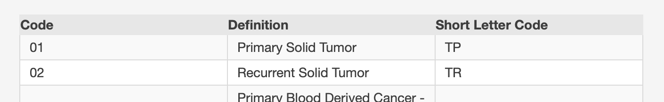
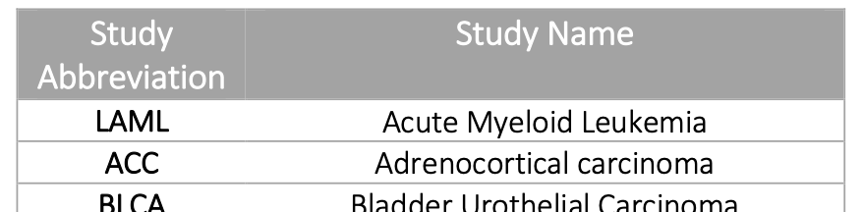
Preprocessing
TCGA sample type codes
Assign samples phenotypic groups
Grouping samples into 84 phenotypic groups based on the sample ID
Cancer type, sample type
TCGA-OR(TSS: tissue source site)-A5J1-01(sample type code)A-11R-A295- 07
Group => ACC-TP
e.g. Sample ID: TCGA-OR-A5J1-01A-11R- A295-07
Notes:
First of all, the raw data had to be preprocessed for further analysis.
I grouped all samples into 84 phenotypic groups based on the sample ID. In raw file, the sample ID contains information of its cancer type and sample type. For example, OR here means adrenocortical carcinoma and 01 is the sample type code for Primary solid Tumor. In this case, this sample was assigned to group ACC-TP.

Slide 7
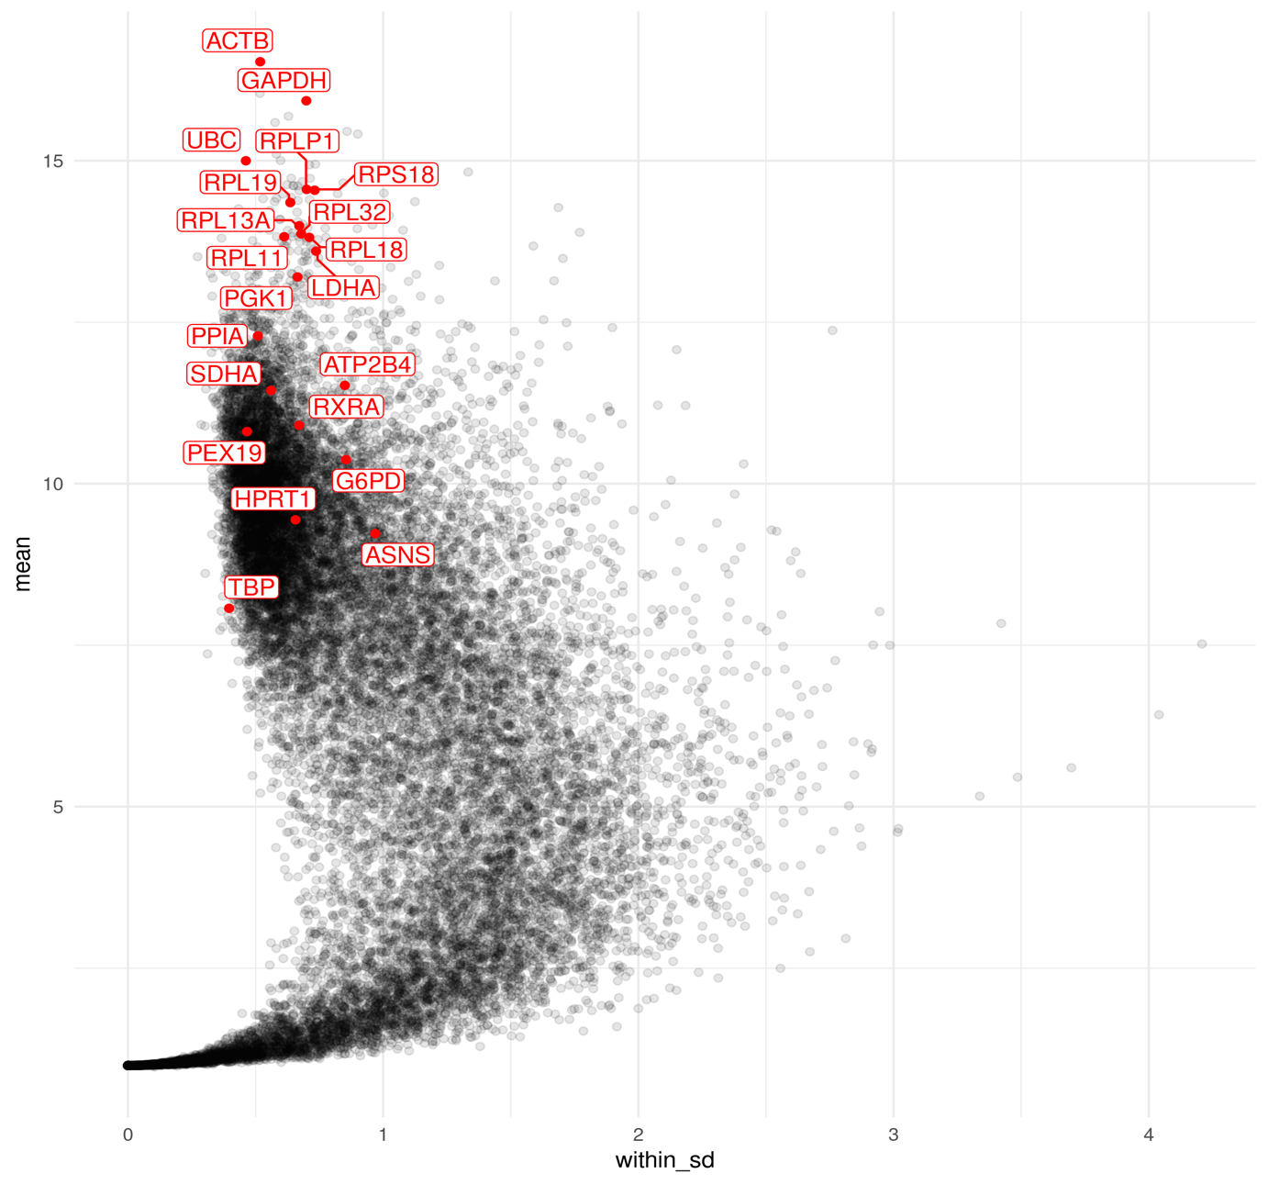
Rare groups that <10 samples in them were removed
52 groups
2. Remove genes with low expressions
Each dot represents a gene
Traditional housekeeping genes are highlighted in red
Genes whose mean expression is smaller than the smallest mean expression of the traditional housekeeping genes were removed.
Mean expression of TBP = 8.07
Notes:
After assigning each of the sample into a specific group. Rare groups that had less than 10 samples in the group were removed. After removal, we had 52 phenotypic groups.
Then we excluded the genes with too low expressions.
This is the plot of mean expression of all of the genes in the sample.
21 traditional housekeeping genes were highlighted in red.
We used the lowest mean expression of these traditional housekeeping gene as a threshold. Here, it was tata box binding protein gene, of mean expression 8.07. So we excluded the genes with their mean expression lower than 8.00.

Slide 8
Statistical analysis
Within-group standard deviation (SD)
Between-group standard deviation
Plot between-group SD against within-group SD
The variation within the group should be minimal.
Genes whose within-group SD >1 were excluded.
7,785 genes in total.
Notes:
For statistical analysis, we calculated the within-group standard deviation and between group standard deviation and plotted the graph.
Because the within-group standard deviation of the traditional housekeeping genes lie within 1. We also wanted to keep the variation within the group to minimal. The genes whose within-group standard deviation was greater than 1 were excluded and we plotted the graph using 7,785 genes.

Slide 9
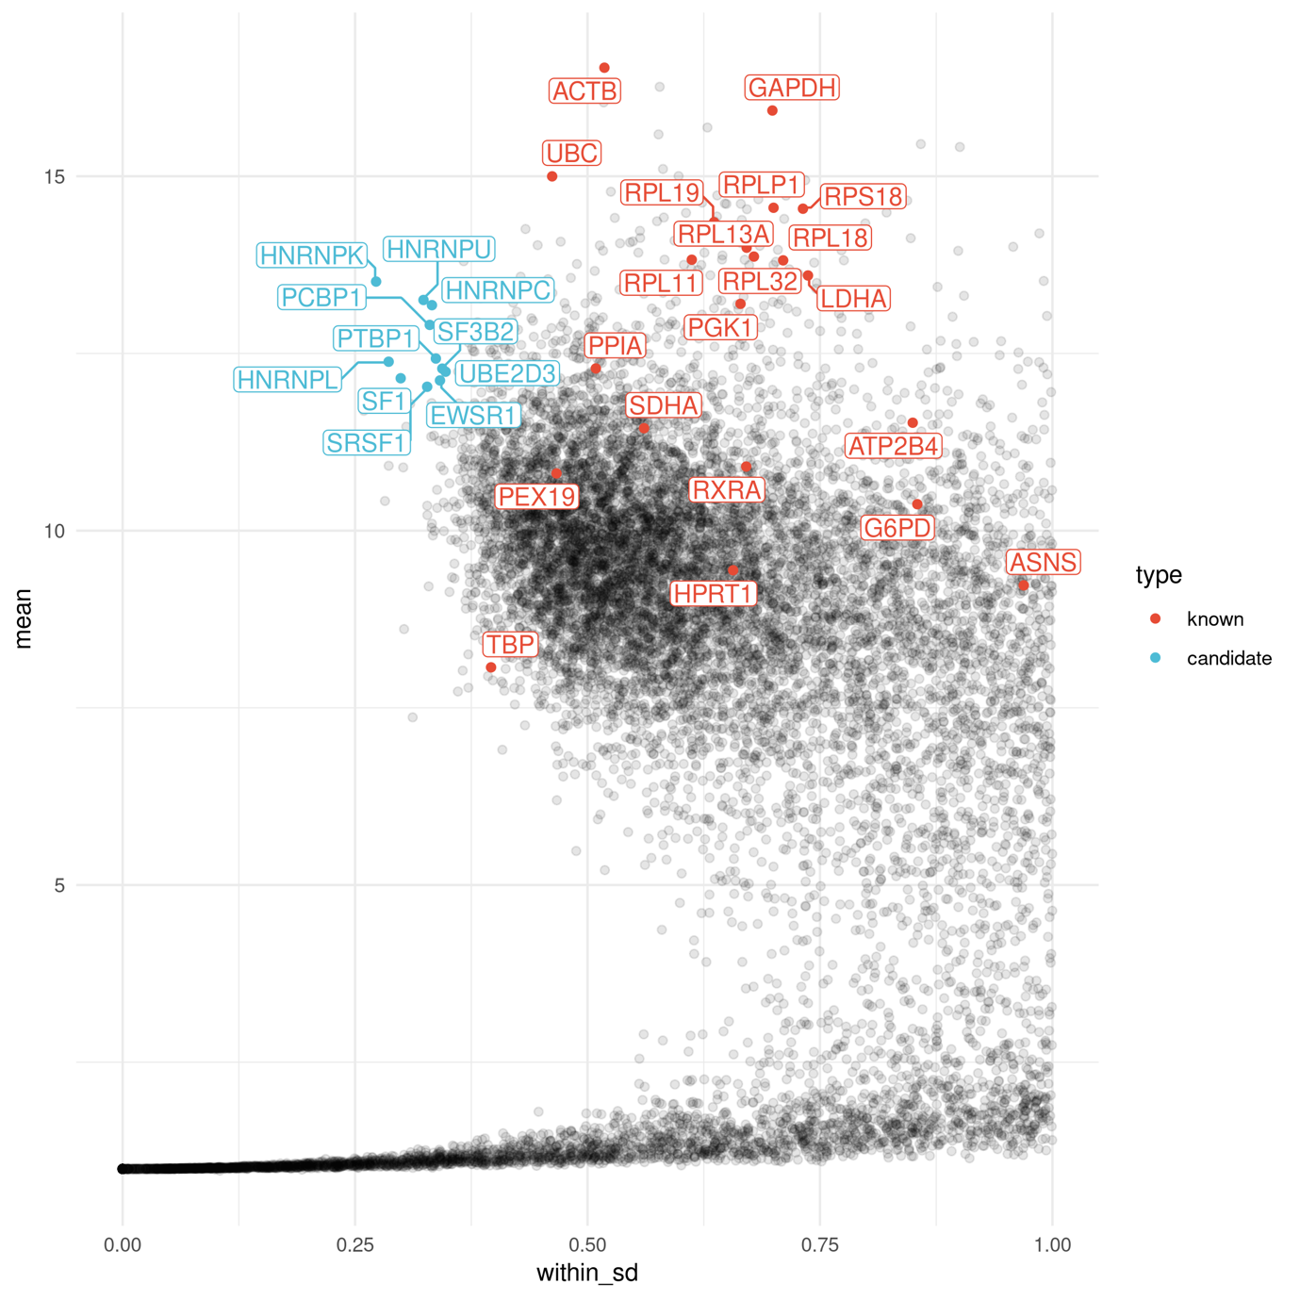
11 genes that are highly expressed and have low within-group standard deviation were highlighted in blue
Considered as potential candidates of housekeeping genes: HNRNPK, HNRNPU, PCBP1, HNRNPC, PTBP1, SF3B2, HNRNPL, SF1, SRSF1, EWSR1, and UBE2D3
Notes:
11 genes that are highly expressed and have lower within-group standard deviation than the traditional housekeeping genes were highlighted in blue. They were considered as potential candidates of housekeeping genes.

Slide 10
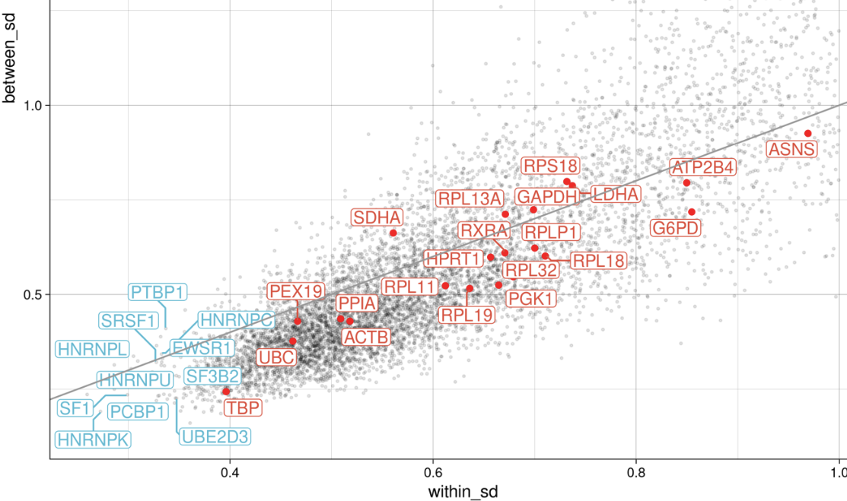
Results
Some genes vary greater between group than within group
PTBP1, HNRNPC, HNRNPL, EWSR1, SDHA, RPL13A, GAPDH, LDHA, and RPS18 are above the identity line
Potential to become context-specific housekeeping genes
Notes:
Then, we looked for the genes that varied greater between groups than within the group. Basically, we focused on the genes that are above the identity line. This was done because they have potential to be context-specific housekeeping genes by excluding some groups that they are oddly upregulated or downregulated.

Slide 11
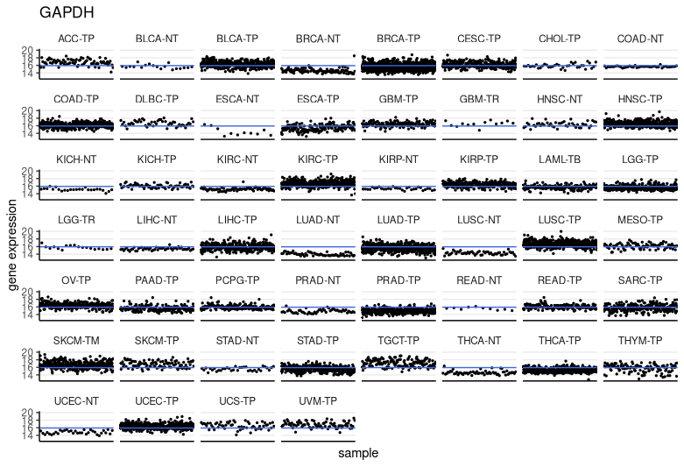
Variation between groups
Notes:
Then, we plotted the expression of each sample in each group. The mean expression of the gene in all of the samples is indicated by the horizontal blue line.

Slide 12
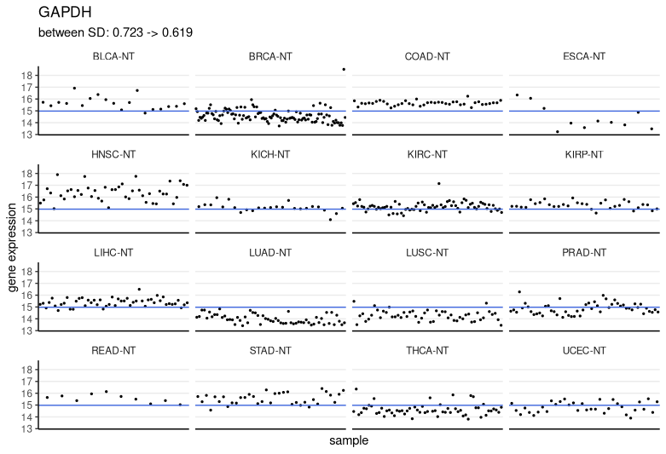
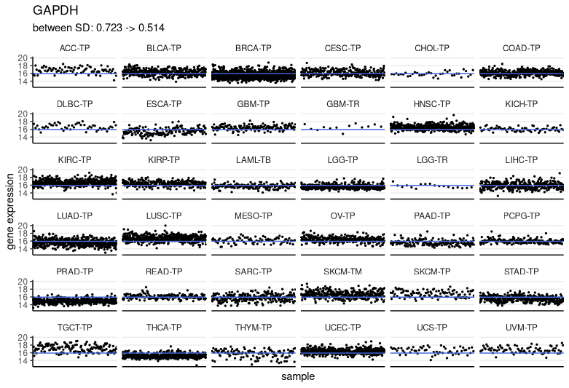
Variation between groups
The expressions in solid normal tissues (NTs) are lower than other groups.
They were excluded and b/w group SD was re-calculated.
b/w group SD decreased from 0.723 to 0.514 after excluding NTs
Notes:
And as we can see, most of the -NT group were downregulated while others generally lied along the mean. So we plotted the graph and calculated the between group SD again after excluding these groups. The result shows that the SD dropped from 0.723 to 0.514.
This indicates that GAPDH may not be the best choice as a reference housekeeping gene in the study that compares a particular gene expression difference between the tumour tissues and the normal tissues.

Slide 13
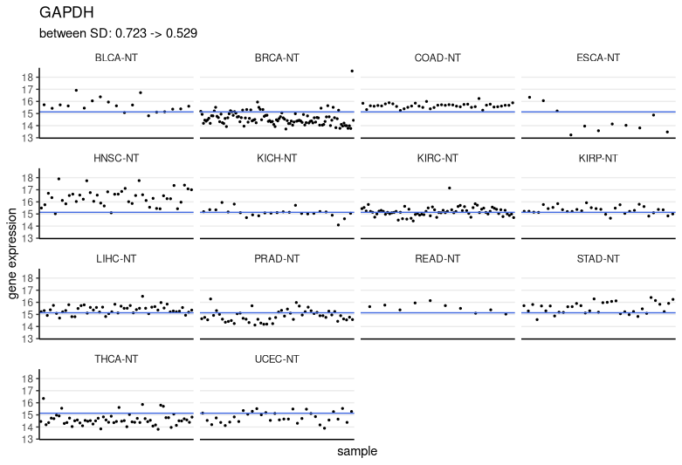
Two lung tissue groups, lung adenocarcinoma (LUAD- NT) and lung squamous cell carcinoma (LUSC-NT) are downregulated even further
0.723 -> 0.529
Notes:
For NT groups, we observed the two lung tissue groups were downregulated even further. The variation between the group decreased even more after removing them from lung groups batch.

Slide 14
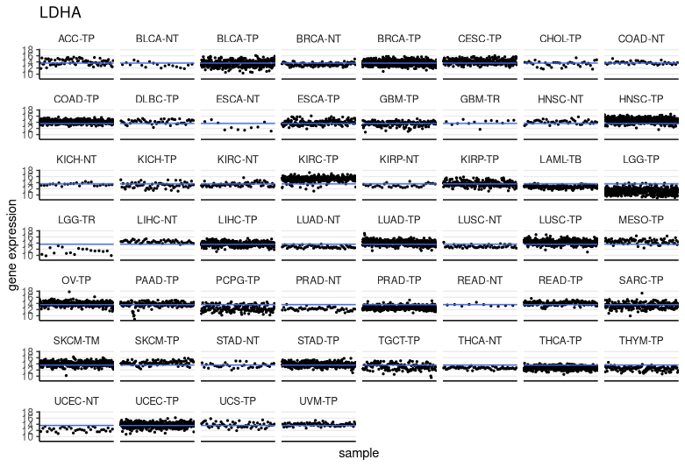
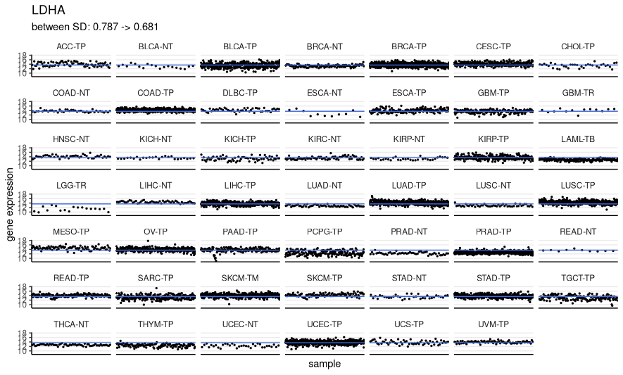
LDHA
Removed upregulated or downregulated genes: KIRC-TP, HNSC-TP, LGG-TP, THCA-TP
0.787 to 0.681
Notes:
For LDHA, the same was done. We pulled out the groups where the gene was upregulated or downregulated, and the btwn group SD decreased.

Slide 15
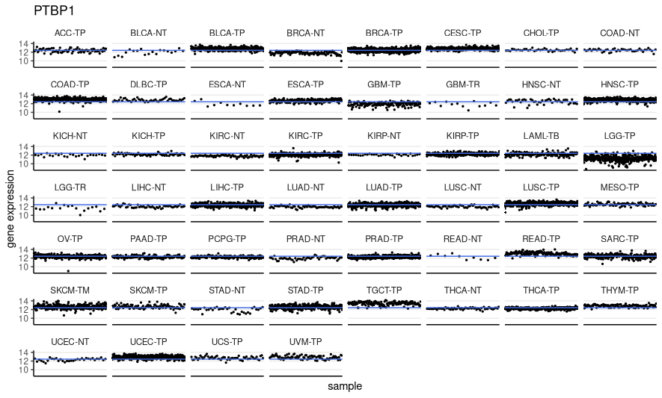
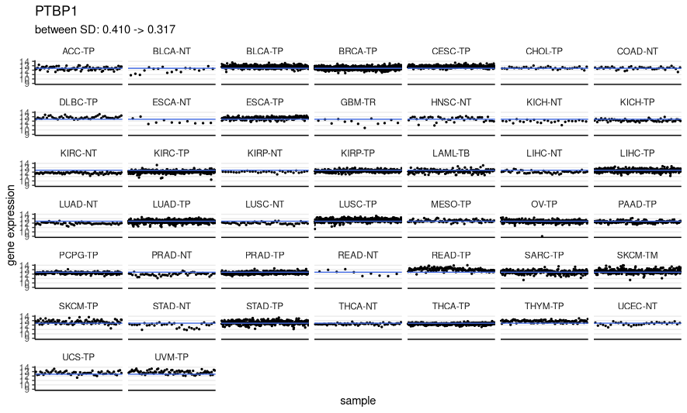
PTBP1
Removed TGCT-TP, COAD-TP, HNSC-TP, UCEC-TP, LGG-TP, LGG-TR, BRCA-NT, GBM-TP
0.410 to 0.317
Notes:
The same was done for PTBP1, and

Slide 16
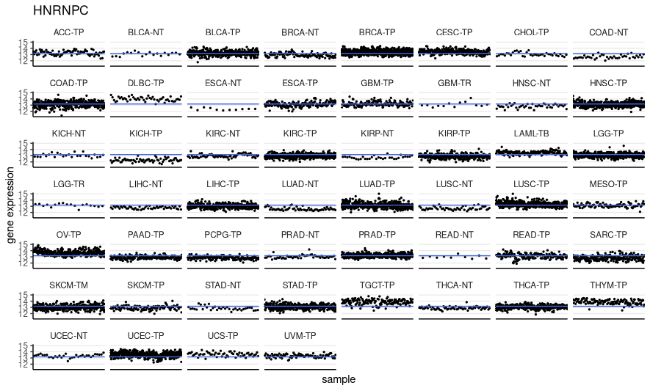
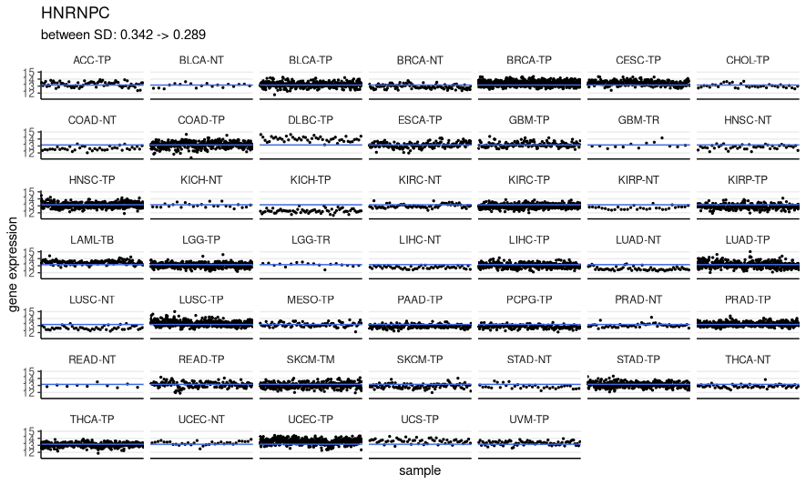
HNRNPC
Removed THYM-TP, OV-TP, TGCT-TP; ESCA-NT and SARC-TP
0.342 to 0.289
Notes:
HNRNPC,

Slide 17
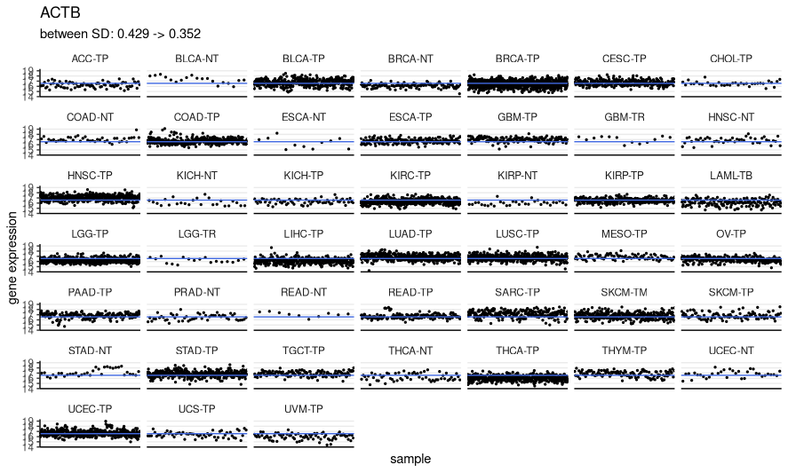
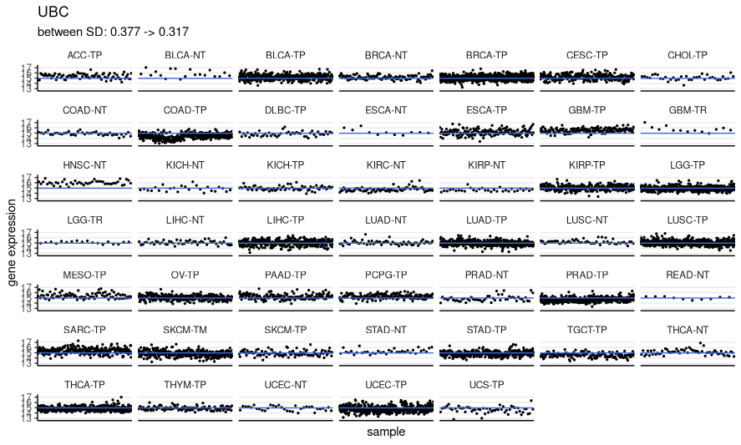
Classic housekeeping genes: ACTB and UBC
ACTB: 0.429 to 0.352
UBC: 0.377 to 0.317
Notes:
And two of classic housekeeping genes, ACTB and UBC

Slide 18
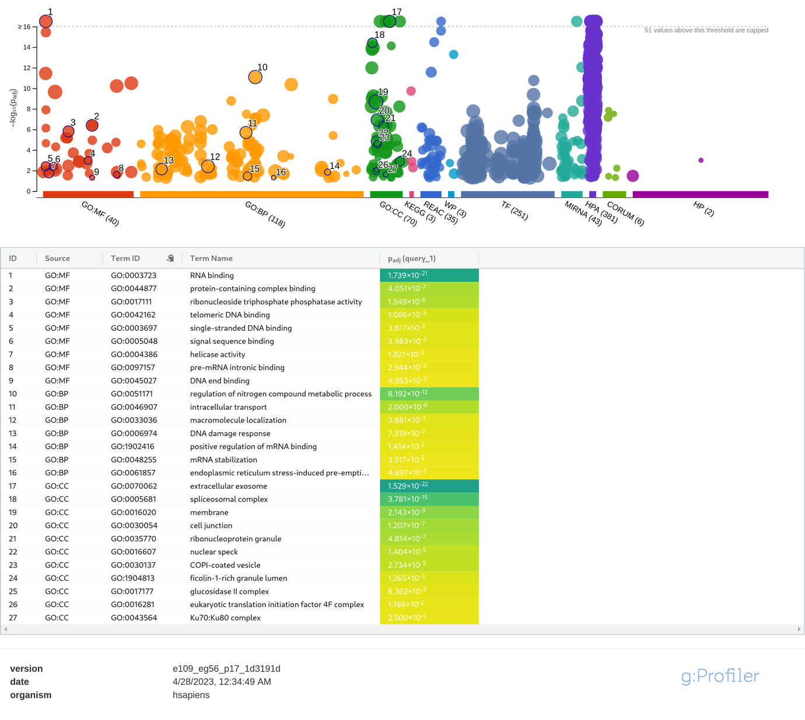
Verifying candidates' identity as housekeeping genes
g:Profiler
123 candidates
Within-group and between-group SD are less than 0.5
Mean expression greater than 12
Enriched/over-represented GO terms
MF: RNA binding, helicase activity and protein complex binding
BP: regulation of nitrogen compound metabolic process, intracellular transport
CC: extracellular exosomes and spliceosomal complexes
The candidates are essential housekeeping genes for the maintenance and survival of the cell
Notes:
123 candidate genes whose within-group and between-group SD are less than 0.5 and mean expression is greater than 12 were run on g:Profiler to confirm their functions are essential housekeeping functions of the cell.
The enriched GO terms were: RNA binding, helicase activity, intracellular transport and etc. The g:Profiler results confirms that the candidates are essential housekeeping genes for the maintenance and survival of the cell.

Slide 19
Conclusion
The study suggested novel candidates of housekeeping genes that can be used as a new internal control in scientific research
The study showed the patterns of non-constitutive expressions numerous different housekeeping genes show depending on the context of the tissue
Identifying and characterizing the right context-specific housekeeping genes for quantification experiments is important
Further study to improve the experiment
Notes:
In conclusion, this study suggested a few novel candidates of housekeeping genes that can be used as a new internal control.
The study also showed the patterns of non-constitutive expressions of housekeeping genes depending on the context of the tissues, as well as improved consistency in expression level by making it context-specific.
To wrap up presentation, I would like to stress out the importance of identifying and characterizing more context-specific housekeeping genes to help build a more valid design of quantification experiments in the biomedical field.

Slide 20
Q&A
Thank you for listening!

Slide 21
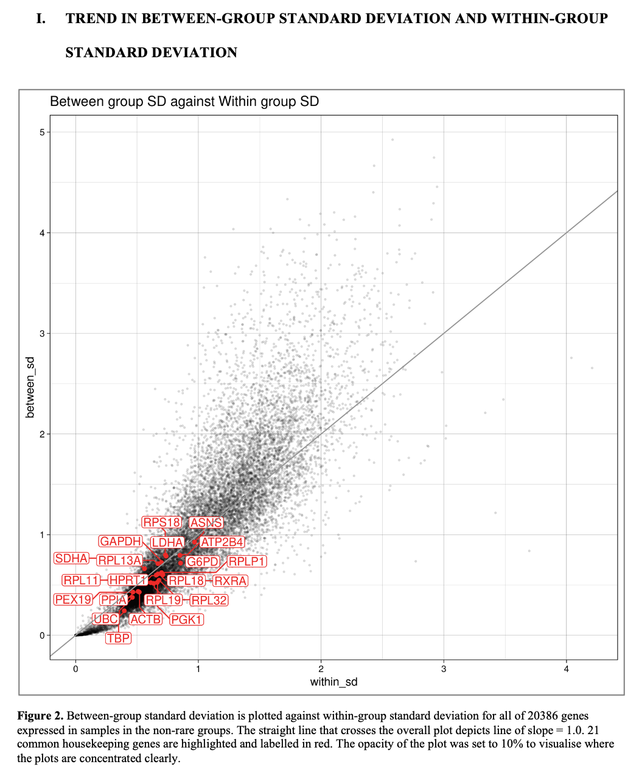

Slide 22
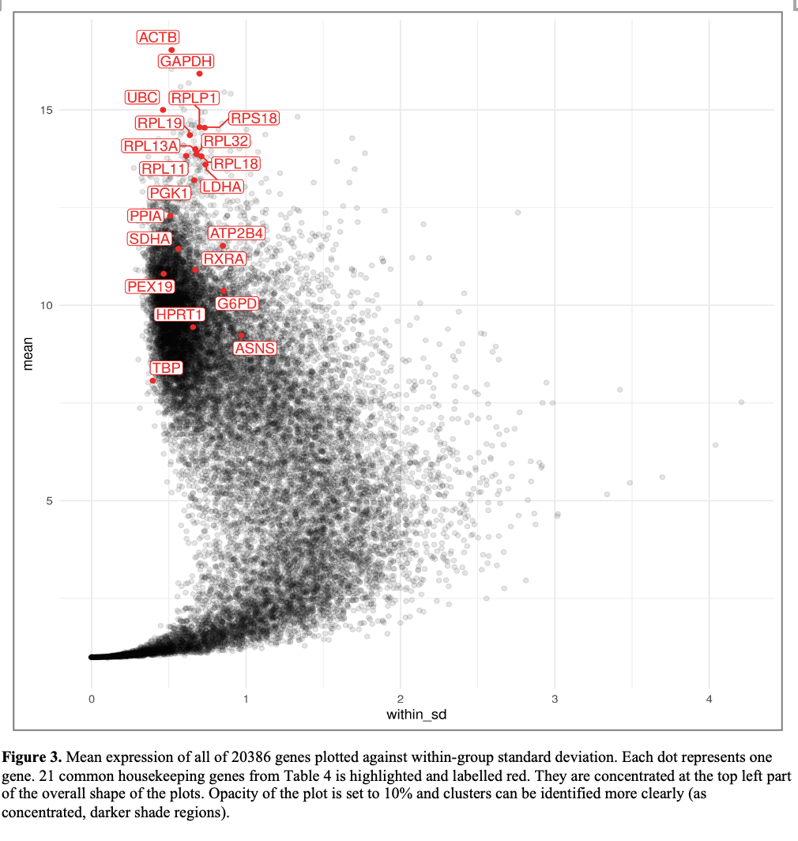

Slide 23
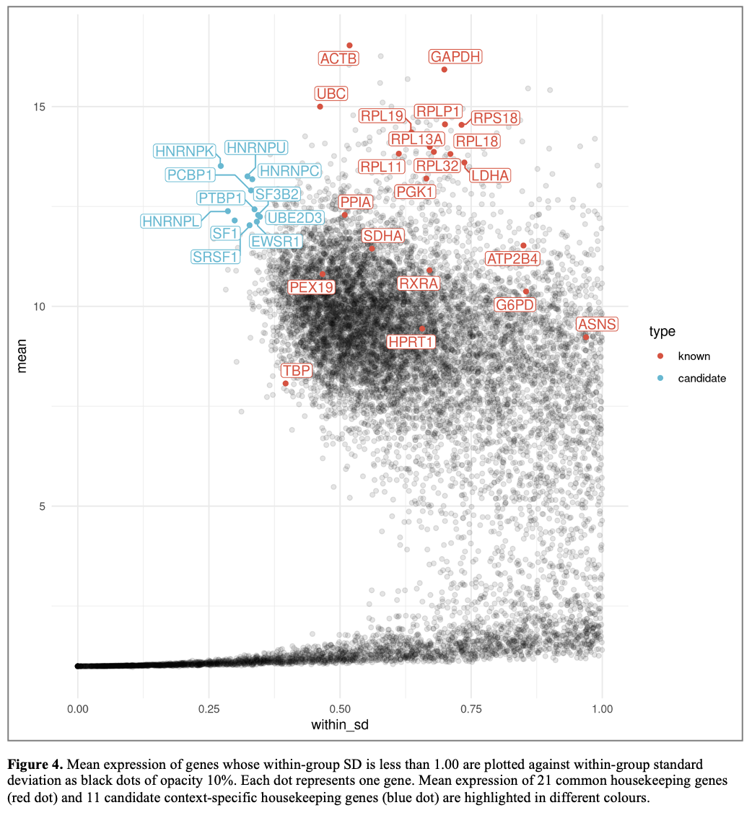

Slide 24
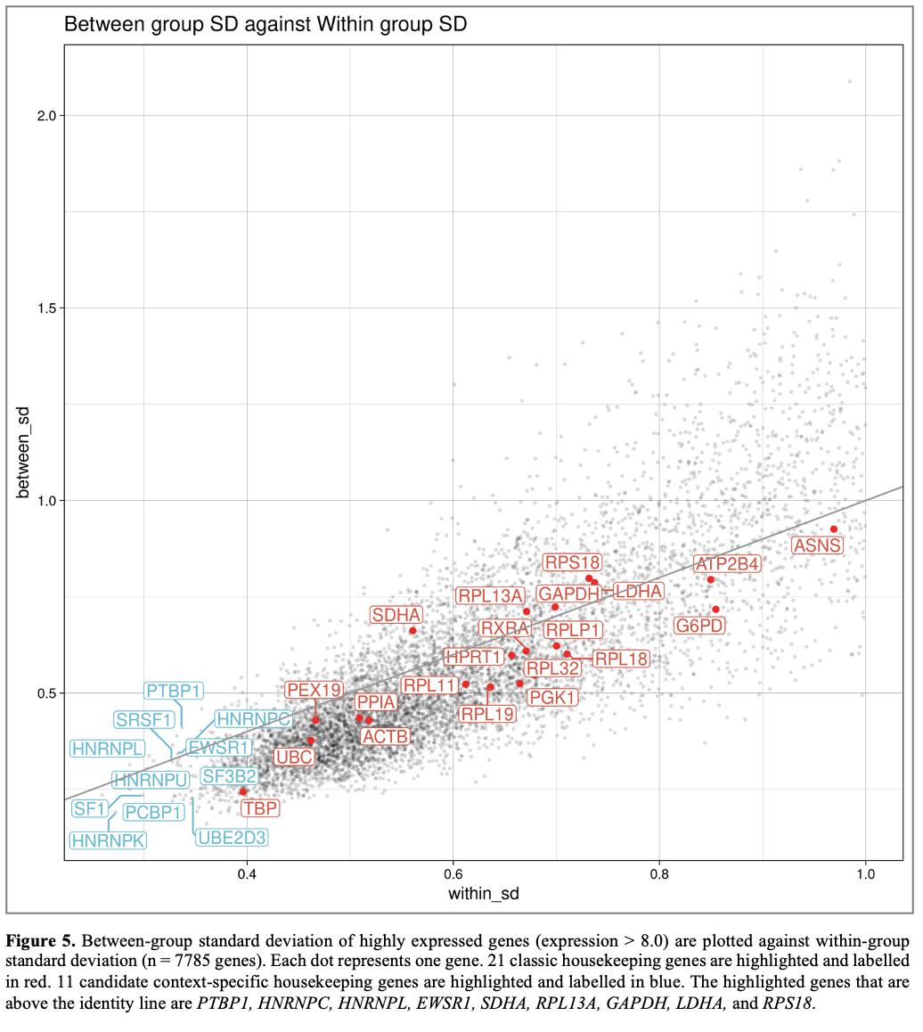

Slide 25
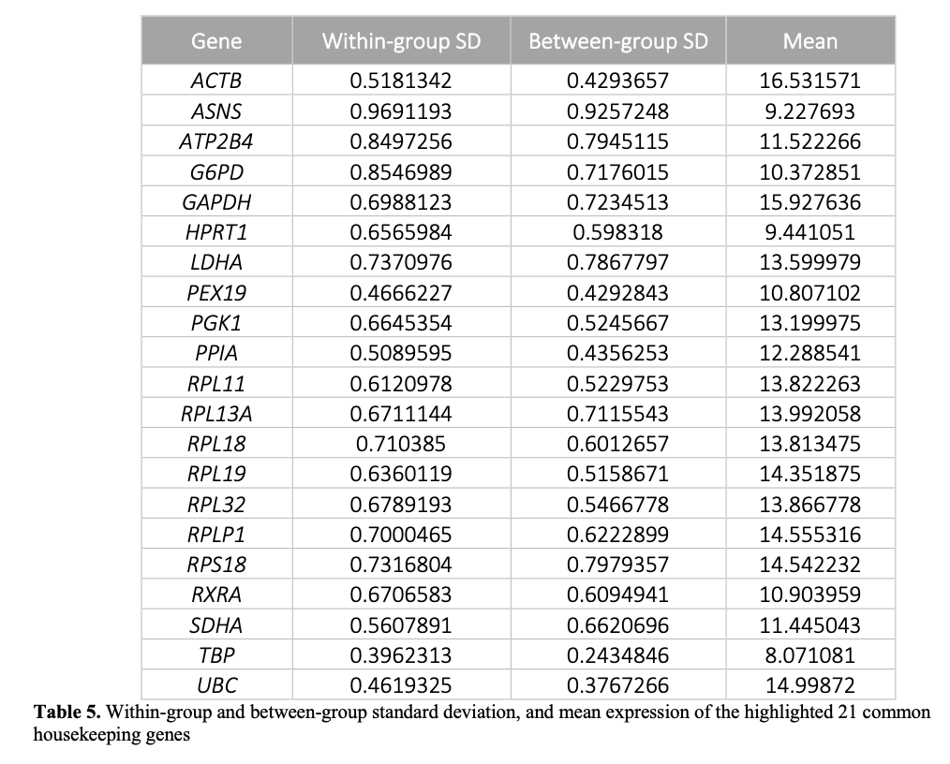

Slide 26
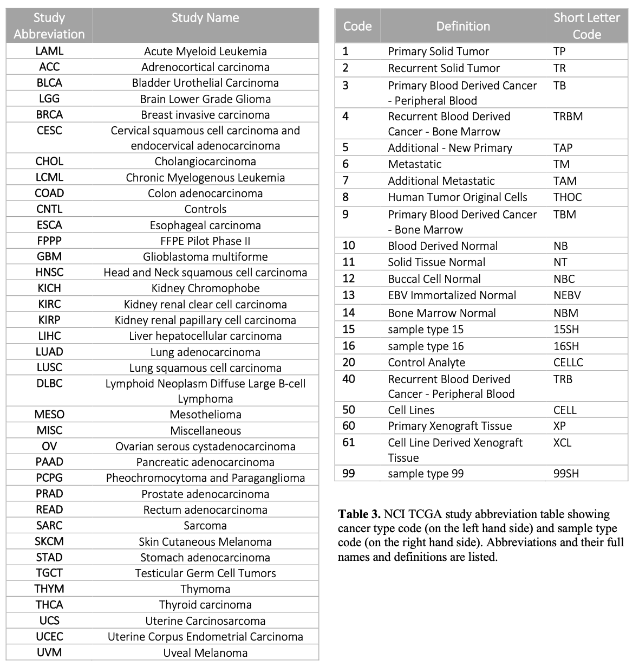

Slide 27
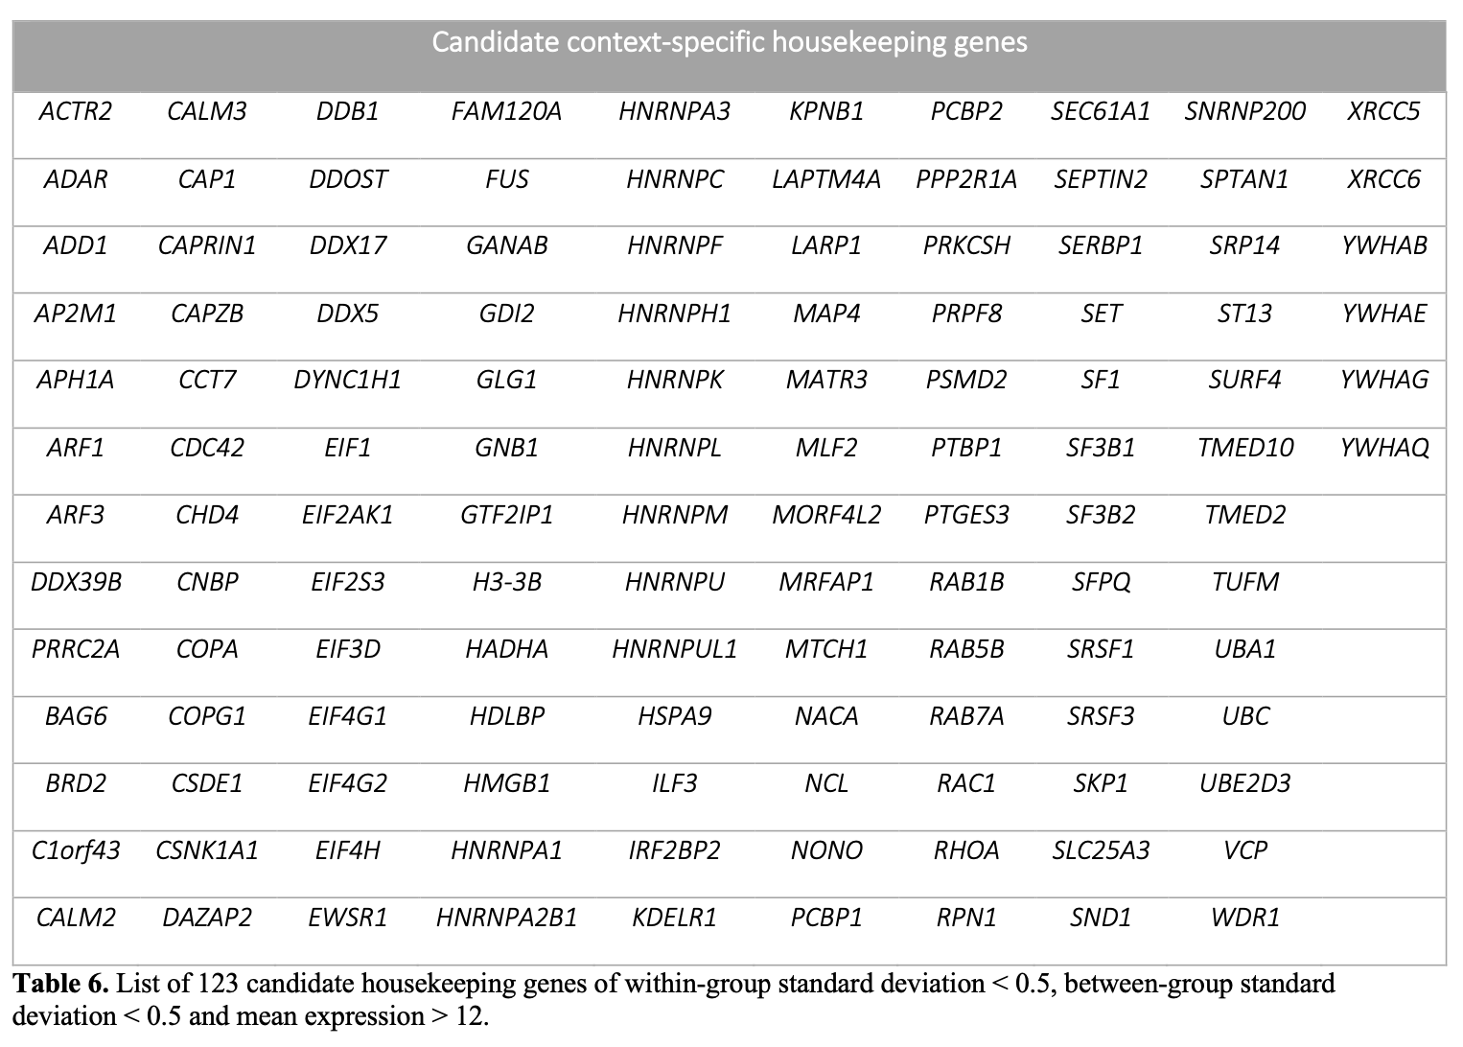

Slide 28
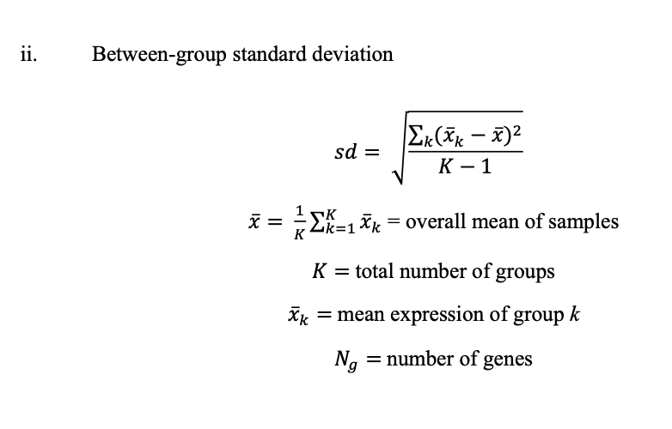
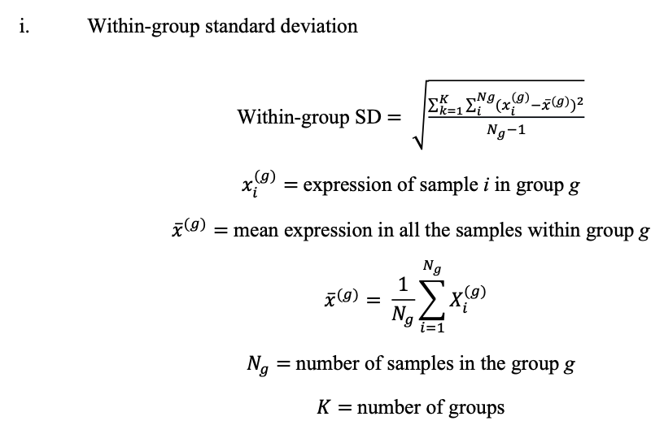
Statistical analysis

Slide 29
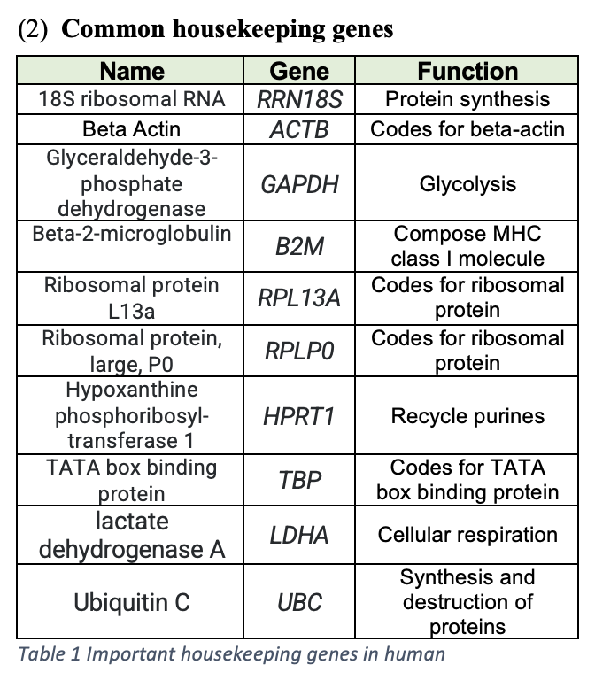
Functions of common housekeeping genes

Slide 30
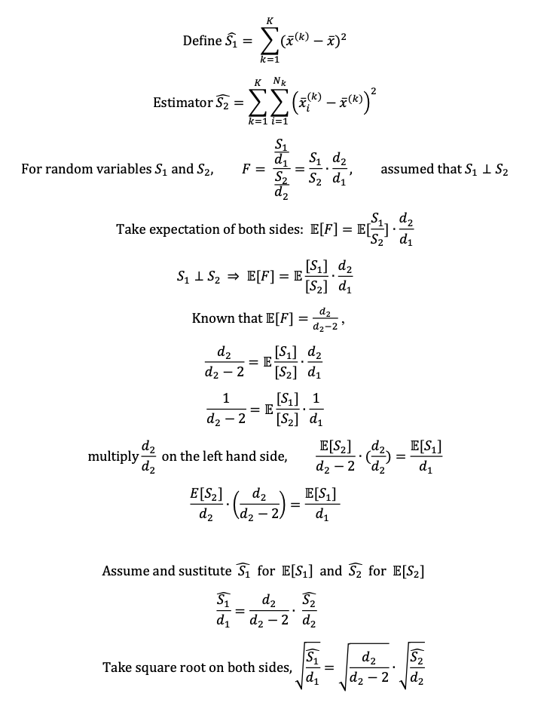
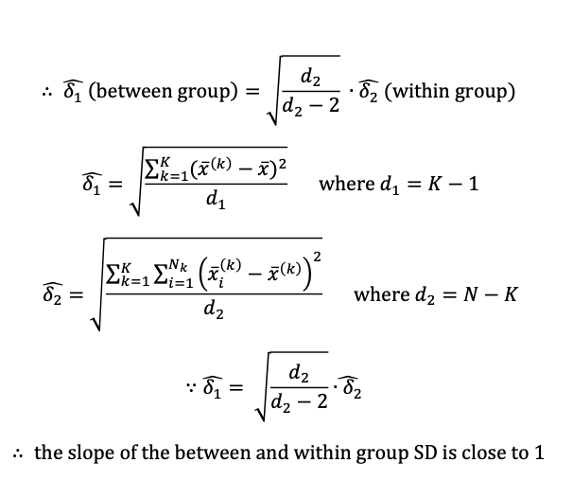
Slope of the line = nearly 1

